Slide 1

Guide to Operating Systems, 5th Edition
Unit 9
Operating Systems Management and Maintenance
Notes:
Guide to Operating Systems, 5th Edition
Chapter 11
Operating Systems Management and Maintenance

Slide 2
Objectives
After completing this chapter, you will be able to:
Explain file system maintenance techniques for different operating systems
Perform regular file system maintenance by finding and deleting unused files and folders
Perform disk maintenance that includes defragmenting, relocating files and folders, running disk and file repair utilities, and selecting RAID options
Guide to Operating Systems, 5th Edition
Notes:
Objectives
After completing this chapter, you will be able to:
Explain file system maintenance techniques for different operating systems
Perform regular file system maintenance by finding and deleting unused files and folders
Perform disk maintenance that includes defragmenting, relocating files and folders, running disk and file repair utilities, and selecting RAID options

Slide 3
Objectives
After completing this chapter, you will be able to (cont’d):
Explain the types of backups and develop a backup plan
Explain how to install software for best performance
Tune operating systems for optimal performance
Guide to Operating Systems, 5th Edition
Notes:
Objectives
After completing this chapter, you will be able to (cont’d):
Explain the types of backups and develop a backup plan
Explain how to install software for best performance
Tune operating systems for optimal performance

Slide 4
File System Maintenance
A well-planned file structure makes it easy to locate files, update files, share folders and files, back up and archive files, and delete unwanted files
Basic rules for creating a file structure:
  Keep a manageable number of folders in the root folder
  Keep OS files in the default folders
  Keep different versions of software in their own folders
  Keep data files in folders on the basis of their functions
Guide to Operating Systems, 5th Edition
Notes:
File System Maintenance
A well-planned file structure makes it easy to locate files, update files, share folders and files, back up and archive files, and delete unwanted files
Basic rules for creating a file structure:
Keep a manageable number of folders in the root folder
Keep OS files in the default folders
Keep different versions of software in their own folders
Keep data files in folders on the basis of their functions

Slide 5
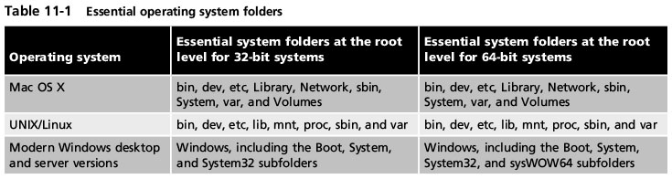
File System Maintenance
Basic rules for creating a file structure (cont’d):
  Design home folders to match the functions of users
  Group files with similar security needs within the same folders
OS folders are typically placed in the root folder
Table 11-1 Essential operating system folders
Guide to Operating Systems, 5th Edition
Notes:
File System Maintenance
Basic rules for creating a file structure (cont’d):
Design home folders to match the functions of users
Group files with similar security needs within the same folders
OS folders are typically placed in the root folder

Slide 6
File System Maintenance
Advantages to installing and leaving OS files in default folders:
  Easier for others to help with computer problems
  Many software installations expect OS files to be in the default locations
In Windows, installed software is tracked in the registry
  Easier for the OS to assist when software must be uninstalled for upgraded because the OS can quickly identify and find relevant components
Guide to Operating Systems, 5th Edition
Notes:
File System Maintenance
Advantages to installing and leaving OS files in default folders:
Easier for others to help with computer problems
Many software installations expect OS files to be in the default locations
In Windows, installed software is tracked in the registry
Easier for the OS to assist when software must be uninstalled for upgraded because the OS can quickly identify and find relevant components

Slide 7
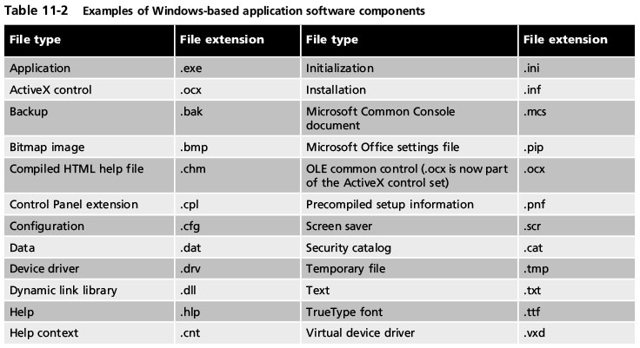
File System Maintenance
Table 11-2 Examples of Windows-based application software components
Guide to Operating Systems, 5th Edition
Notes:
File System Maintenance

Slide 8
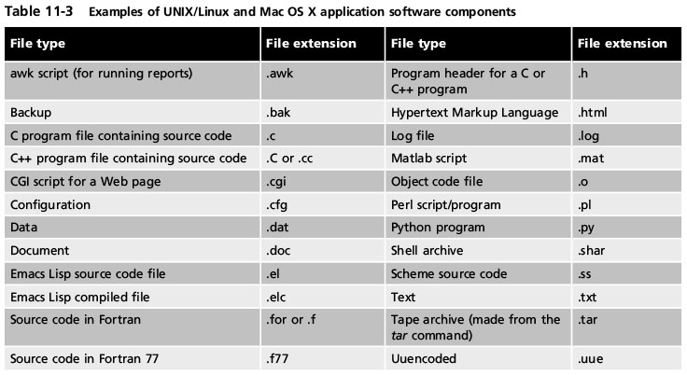
File System Maintenance
Table 11-3 Examples of UNIX/Linux and Mac OS X application software components
Guide to Operating Systems, 5th Edition
Notes:
File System Maintenance

Slide 9
File System Maintenance
If different versions of software are still used:
  Put different versions in different subfolders under a main applications folder
  Example: in Windows Server you can support different version of Microsoft Word by having a Program Files folder and subfolders called Word2013 and Word2016
  Also, Microsoft 64-bit OSs offer the Program Files and Program Files (x86) folders to separate 64-bit and 32-bit applications
Guide to Operating Systems, 5th Edition
Notes:
File System Maintenance
If different versions of software are still used:
Put different versions in different subfolders under a main applications folder
Example: in Windows Server you can support different version of Microsoft Word by having a Program Files folder and subfolders called Word2013 and Word2016
Also, Microsoft 64-bit OSs offer the Program Files and Program Files (x86) folders to separate 64-bit and 32-bit applications

Slide 10
Finding and Deleting Files
A solid file structure makes it easier to find and delete unneeded files
  Example: temporary files are often created when running some applications and are sometimes not deleted automatically
    Temporary Internet files (cookies) are often not deleted automatically
It is good practice to implement a regular schedule for finding and deleting unneeded files
Guide to Operating Systems, 5th Edition
Notes:
Finding and Deleting Files
A solid file structure makes it easier to find and delete unneeded files
Example: temporary files are often created when running some applications and are sometimes not deleted automatically
Temporary Internet files (cookies) are often not deleted automatically
It is good practice to implement a regular schedule for finding and deleting unneeded files

Slide 11
Deleting Temporary Files in Windows
In Windows, temporary files are typically located in the /Temp and /Windows/Temp folders
  Or in users’ home folders
Use the Disk Cleanup tool to delete unneeded files
In Windows 8 and later versions
  The Disk Cleanup tool is scheduled to automatically run on the system drive where Windows is installed
You should also regularly open the Recycle Bin and delete its files
  You can also delete these files using the Disk Cleanup tool
Guide to Operating Systems, 5th Edition
Notes:
Deleting Temporary Files in Windows
In Windows, temporary files are typically located in the /Temp and /Windows/Temp folders
Or in users’ home folders
Use the Disk Cleanup tool to delete unneeded files
In Windows 8 and later versions
The Disk Cleanup tool is scheduled to automatically run on the system drive where Windows is installed
You should also regularly open the Recycle Bin and delete its files
You can also delete these files using the Disk Cleanup tool

Slide 12
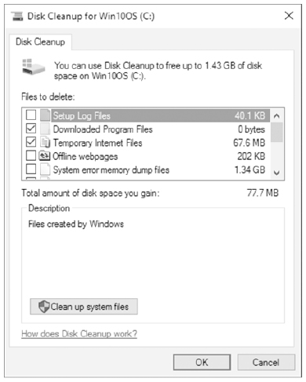
Deleting Temporary Files in Windows
Figure 11-1 The Disk Cleanup tool in Windows
Guide to Operating Systems, 5th Edition
Notes:
Deleting Temporary Files in Windows

Slide 13
Deleting Files in UNIX/Linux
View UNIX/Linux files by using the ls command
  Some of the options that can be used with this command:
    -a lists all files including hidden files
    -C formats the listing in columns for easier reading
    -d lists folders
    -f displays files in an unsorted list
    -l presents detailed information including permissions and file size
    -r sorts files in reverse alphabetical order
    -s displays the size of files (in blocks)
Guide to Operating Systems, 5th Edition
Notes:
Deleting Files in UNIX/Linux
View UNIX/Linux files by using the ls command
Some of the options that can be used with this command:
-a lists all files including hidden files
-C formats the listing in columns for easier reading
-d lists folders
-f displays files in an unsorted list
-l presents detailed information including permissions and file size
-r sorts files in reverse alphabetical order
-s displays the size of files (in blocks)

Slide 14
Deleting Files in UNIX/Linux
View UNIX/Linux files by using the ls command
  Some of the options that can be used with this command (cont’d):
    -S sorts files and folders on the basis of size
    -t sorts files and folders on the basis of time they were last modified
  Example: ls –a lists all files including hidden files
Guide to Operating Systems, 5th Edition
Notes:
Deleting Files in UNIX/Linux
View UNIX/Linux files by using the ls command
Some of the options that can be used with this command (cont’d):
-S sorts files and folders on the basis of size
-t sorts files and folders on the basis of time they were last modified
Example: ls –a lists all files including hidden files

Slide 15
Deleting Files in UNIX/Linux
Files and folders are deleted using the rm command
  Options for this command:
    -i for interactive option (asks if you are sure you want to delete)
    -r for recursive (deletes an entire folder’s contents)
  Example: rm /home/mjackson/docs *.txt
    This command will delete all files with a .txt extension in the mjackson directory
In the Linux GNOME File tool, you delete a file by finding the file, clicking on it and pressing the delete key on your keyboard
Guide to Operating Systems, 5th Edition
Notes:
Deleting Files in UNIX/Linux
Files and folders are deleted using the rm command
Options for this command:
-i for interactive option (asks if you are sure you want to delete)
-r for recursive (deletes an entire folder’s contents)
Example: rm /home/mjackson/docs *.txt
This command will delete all files with a .txt extension in the mjackson directory
In the Linux GNOME File tool, you delete a file by finding the file, clicking on it and pressing the delete key on your keyboard

Slide 16
Deleting Files in UNIX/Linux
A file can be found by using the find command
  Options that can be used with this command:
    -atime for last access time
    -ctime for last changed time
    -mtime for last modification time
    -name for the filename, including the use of wildcard searches
    -print to print the results of the find
    -size for file size (in blocks or bytes; with bytes specified by a “c”)
    -user to find files by ownership
Guide to Operating Systems, 5th Edition
Notes:
Deleting Files in UNIX/Linux
A file can be found by using the find command
Options that can be used with this command:
-atime for last access time
-ctime for last changed time
-mtime for last modification time
-name for the filename, including the use of wildcard searches
-print to print the results of the find
-size for file size (in blocks or bytes; with bytes specified by a “c”)
-user to find files by ownership

Slide 17
Deleting Files in UNIX/Linux
Example: if you are looking for a file called file1 in order to delete it from your home folder, use:
  find ~ -name file1
Another example: to find a all files in directory/usr that are owned by the user lpadron:
  find /usr –user lpadron
Linux GNOME file tool offers a trash can for deleting files permanently
  Periodically view the contents of Trash and purge them by clicking Trash in Files and click Empty
Guide to Operating Systems, 5th Edition
Notes:
Deleting Files in UNIX/Linux
Example: if you are looking for a file called file1 in order to delete it from your home folder, use:
find ~ -name file1
Another example: to find a all files in directory/usr that are owned by the user lpadron:
find /usr –user lpadron
Linux GNOME file tool offers a trash can for deleting files permanently
Periodically view the contents of Trash and purge them by clicking Trash in Files and click Empty

Slide 18
Deleting Files in UNIX/Linux
UNIX/Linux provides commands to help you assess the allocation of disk space:
  df – enables you to view information on the basis of the file system
  du – used to display statistics for a given directory and its subdirectories
Guide to Operating Systems, 5th Edition
Notes:
Deleting Files in UNIX/Linux
UNIX/Linux provides commands to help you assess the allocation of disk space:
df – enables you to view information on the basis of the file system
du – used to display statistics for a given directory and its subdirectories

Slide 19
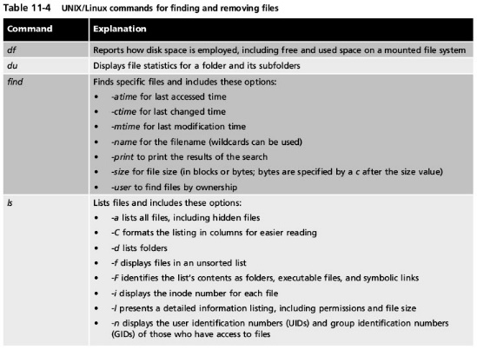
Deleting Files in UNIX/Linux
Table 11-4 UNIX/Linux commands for finding and removing files
Guide to Operating Systems, 5th Edition
Notes:
Deleting Files in UNIX/Linux

Slide 20
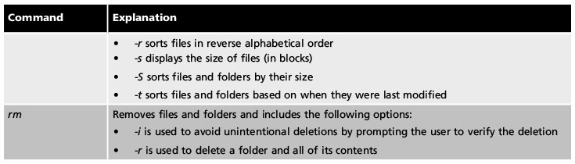
Deleting Files in UNIX/Linux
Table 11-4 UNIX/Linux commands for finding and removing files (continued)
Guide to Operating Systems, 5th Edition
Notes:
Deleting Files in UNIX/Linux

Slide 21
Deleting Files in Mac OS X
Mac OS X is generally effective in automatically cleaning out temporary files
  However, still important to periodically find and delete unneeded files
Mac OS X windows often have a list option that shows files and their sizes
  Click the List view button in the window to see file sizes
Guide to Operating Systems, 5th Edition
Notes:
Deleting Files in Mac OS X
Mac OS X is generally effective in automatically cleaning out temporary files
However, still important to periodically find and delete unneeded files
Mac OS X windows often have a list option that shows files and their sizes
Click the List view button in the window to see file sizes

Slide 22
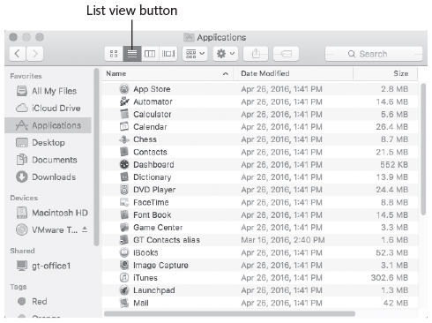
Deleting Files in Mac OS X
Figure 11-2 Viewing file sizes in Mac OS X
Guide to Operating Systems, 5th Edition
Notes:
Deleting Files in Mac OS X

Slide 23
Maintaining Disks
It is important to perform disk maintenance in order to maintain the integrity of files and ensure disk performance
Important disk maintenance tasks include:
  Defragmenting disks
  Moving files to spread the load between multiple disks
  Using disk utilities to find and repair damaged files
  Deploying RAID techniques that extend the life of disks and provide disk redundancy
Guide to Operating Systems, 5th Edition
Notes:
Maintaining Disks
It is important to perform disk maintenance in order to maintain the integrity of files and ensure disk performance
Important disk maintenance tasks include:
Defragmenting disks
Moving files to spread the load between multiple disks
Using disk utilities to find and repair damaged files
Deploying RAID techniques that extend the life of disks and provide disk redundancy

Slide 24
Defragmenting Disks
Fragmentation – unused space develops between files and other information written on a disk
When an OS is first installed, files are placed contiguously on a disk (little or no unused space between files)
As the OS deletes files, creates new files, and modifies files, the unused space between them grows and becomes scattered
The greater the fragmentation, the more space is wasted
Guide to Operating Systems, 5th Edition
Notes:
Defragmenting Disks
Fragmentation – unused space develops between files and other information written on a disk
When an OS is first installed, files are placed contiguously on a disk (little or no unused space between files)
As the OS deletes files, creates new files, and modifies files, the unused space between them grows and becomes scattered
The greater the fragmentation, the more space is wasted

Slide 25
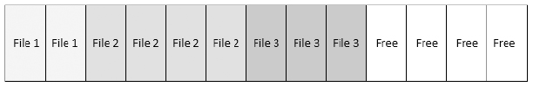
Defragmenting Disks
Figure 11-3 An unfragmented disk
Guide to Operating Systems, 5th Edition
Notes:
Defragmenting Disks

Slide 26
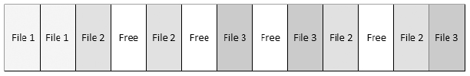
Defragmenting Disks
Figure 11-4 An fragmented disk
Guide to Operating Systems, 5th Edition
Notes:
Defragmenting Disks

Slide 27
Defragmenting Disks
Defragmentation – process of removing empty pockets between files and other information on a hard drive
Ways to defragment:
  Older method is to take a complete backup of a disk’s contents and perform a full restore
    Some administrators run a surface analysis of a disk before the restore to find damaged disk sectors and tracks
Guide to Operating Systems, 5th Edition
Notes:
Defragmenting Disks
Defragmentation – process of removing empty pockets between files and other information on a hard drive
Ways to defragment:
Older method is to take a complete backup of a disk’s contents and perform a full restore
Some administrators run a surface analysis of a disk before the restore to find damaged disk sectors and tracks

Slide 28
Defragmenting Disks
Ways to defragment (cont’d):
  Another option is to run a disk defragmentation tool
    Many OSs come with a built-in tool to defragment disks
    Some can run in the background as you use your computer
    Some perform a quick analysis to see if defrag is even needed
      If disk fragmentation is 20% or less, the disk does not need to be defragmented immediately
Guide to Operating Systems, 5th Edition
Notes:
Defragmenting Disks
Ways to defragment (cont’d):
Another option is to run a disk defragmentation tool
Many OSs come with a built-in tool to defragment disks
Some can run in the background as you use your computer
Some perform a quick analysis to see if defrag is even needed
If disk fragmentation is 20% or less, the disk does not need to be defragmented immediately

Slide 29
Defragmenting Disks
In UNIX/Linux and Mac OS X, file systems are designed to reduce the need for defragmenting
  OSs first write to a hidden journal, which is loaded to memory and then contents are written to disk in a linear fashion
    Linear – data is temporarily stored and written all at one time in more contiguous fashion
    Sequential – data is not stored but written as soon as it is created and therefore written to whatever disk areas are immediately open
  Defragmentation tools are usually not included with these OSs
Guide to Operating Systems, 5th Edition
Notes:
Defragmenting Disks
In UNIX/Linux and Mac OS X, file systems are designed to reduce the need for defragmenting
OSs first write to a hidden journal, which is loaded to memory and then contents are written to disk in a linear fashion
Linear – data is temporarily stored and written all at one time in more contiguous fashion
Sequential – data is not stored but written as soon as it is created and therefore written to whatever disk areas are immediately open
Defragmentation tools are usually not included with these OSs

Slide 30
Moving Disk Files to Spread the Load
A technique that can help extend the life of disk drives is to spread files evenly across disks
  Usually used in servers
  Before files are moved, administrators examine disk and file activity to determine how to spread files to achieve even loading
  Disk activity is monitored in Windows using Task Manager, Resource Monitor, and Performance Monitor
  For a quick look at current disk utilization, use Resource Monitor
Guide to Operating Systems, 5th Edition
Notes:
Moving Disk Files to Spread the Load
A technique that can help extend the life of disk drives is to spread files evenly across disks
Usually used in servers
Before files are moved, administrators examine disk and file activity to determine how to spread files to achieve even loading
Disk activity is monitored in Windows using Task Manager, Resource Monitor, and Performance Monitor
For a quick look at current disk utilization, use Resource Monitor

Slide 31
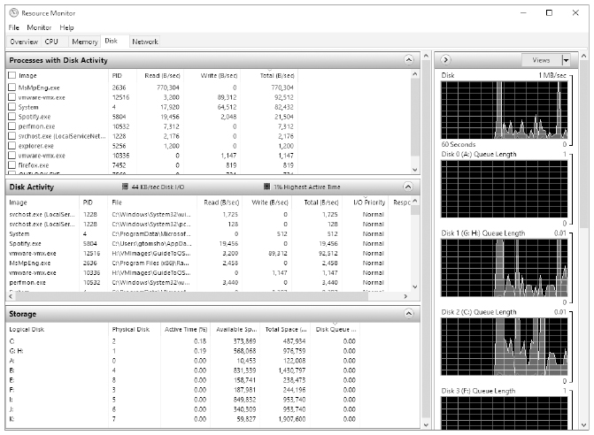
Moving Disk Files to Spread the Load
Figure 11-5 Using Resource Monitor to view disk usage
Guide to Operating Systems, 5th Edition
Notes:
Moving Disk Files to Spread the Load

Slide 32
Using Disk Utilities to Repair Damaged Files
The following utilities enable you to repair damaged files and file links:
  Disk First Aid in the Mac OS X Disk Utility
  fsck and p_fsck in UNIX/Linux
  chkdsk in Windows
Guide to Operating Systems, 5th Edition
Notes:
Using Disk Utilities to Repair Damaged Files
The following utilities enable you to repair damaged files and file links:
Disk First Aid in the Mac OS X Disk Utility
fsck and p_fsck in UNIX/Linux
chkdsk in Windows

Slide 33
Deploying RAID Techniques
RAID - used by server operating systems for three purposes:
  Increased reliability (providing data recovery when a disk drive fails and extending the useful life of disks)
  Increased storage capacity
  Increased speed
This section focuses on how RAID is used to extend the life of a set of disks
  RAID does this using disk striping – technique for spreading data over multiple disk volumes
Guide to Operating Systems, 5th Edition
Notes:
Deploying RAID Techniques
RAID - used by server operating systems for three purposes:
Increased reliability (providing data recovery when a disk drive fails and extending the useful life of disks)
Increased storage capacity
Increased speed
This section focuses on how RAID is used to extend the life of a set of disks
RAID does this using disk striping – technique for spreading data over multiple disk volumes

Slide 34
Deploying RAID Techniques
Earlier, you were introduced to many levels of RAID
  Only those that use disk striping distribute the load across multiple disks: RAID 0 and RAID 5
  Another RAID level, not discussed earlier, is RAID 10 which provides striping plus mirroring
  RAID levels 2, 3, and 4 are rarely used because levels 1, 5, and 10 provide better fault tolerance
Two ways to deploy RAID: hardware and software
  Software RAID is slower than hardware RAID
Guide to Operating Systems, 5th Edition
Notes:
Deploying RAID Techniques
Earlier, you were introduced to many levels of RAID
Only those that use disk striping distribute the load across multiple disks: RAID 0 and RAID 5
Another RAID level, not discussed earlier, is RAID 10 which provides striping plus mirroring
RAID levels 2, 3, and 4 are rarely used because levels 1, 5, and 10 provide better fault tolerance
Two ways to deploy RAID: hardware and software
Software RAID is slower than hardware RAID

Slide 35
Making Backups
Several types of backups:
  Binary backup – backs up the disk contents in binary format to create an exact image of the disk contents
    Simple to perform and includes everything on the disk
    Disadvantage – cannot restore individual files or directories
  Full file-by-file backup – all of the disk contents are back up, but as individual directories and files
    Enables you to restore a single directory or a set of files without restoring the entire disk
Guide to Operating Systems, 5th Edition
Notes:
Making Backups
Several types of backups:
Binary backup – backs up the disk contents in binary format to create an exact image of the disk contents
Simple to perform and includes everything on the disk
Disadvantage – cannot restore individual files or directories
Full file-by-file backup – all of the disk contents are back up, but as individual directories and files
Enables you to restore a single directory or a set of files without restoring the entire disk

Slide 36
Making Backups
Several types of backups (cont’d):
  Differential backup – backs up all files that have an archive attribute (indicates that the file needs to be backed up)
  Incremental backup – backs up all files that have the archive attribute, and removes the attribute from each file after backup
Guide to Operating Systems, 5th Edition
Notes:
Making Backups
Several types of backups (cont’d):
Differential backup – backs up all files that have an archive attribute (indicates that the file needs to be backed up)
Incremental backup – backs up all files that have the archive attribute, and removes the attribute from each file after backup

Slide 37
Making Backups
Basic backup scheme might include:
  Full file-by-file backup to tape each Saturday evening and differential backups to tape Monday through Friday
  The business might also have four sets of tapes that are rotated each week
    First tape set would be used in week 1
    Second tape set would be used in week 2, and so on
    If one tape set goes bad, there is an option to use one of the tape sets from a previous week to restore, if needed
Guide to Operating Systems, 5th Edition
Notes:
Making Backups
Basic backup scheme might include:
Full file-by-file backup to tape each Saturday evening and differential backups to tape Monday through Friday
The business might also have four sets of tapes that are rotated each week
First tape set would be used in week 1
Second tape set would be used in week 2, and so on
If one tape set goes bad, there is an option to use one of the tape sets from a previous week to restore, if needed

Slide 38
Making Backups
Basic backup scheme might include (cont’d):
  If there was a catastrophic disk failure on Thursday:
    The business would restore the full backup from the previous Saturday and restore the differential backup from Wednesday night
For small server backups, a simple solution is to use the ability of the native backup software to periodically back up new files
  Mac OS X Time Machine enables you to leave a removable hard drive connected to the computer so it can back up any file changes after they occur
Guide to Operating Systems, 5th Edition
Notes:
Making Backups
Basic backup scheme might include (cont’d):
If there was a catastrophic disk failure on Thursday:
The business would restore the full backup from the previous Saturday and restore the differential backup from Wednesday night
For small server backups, a simple solution is to use the ability of the native backup software to periodically back up new files
Mac OS X Time Machine enables you to leave a removable hard drive connected to the computer so it can back up any file changes after they occur

Slide 39
Making Backups
When creating a backup strategy:
  Determine what information needs to be backed up and how often
  Use scheduling
  Choose the right backup media
  Rotate backup media
  Store a set of backups in an off-site location
  Regularly use file repair tools and a virus checker
  Investigate third-party backup software
Guide to Operating Systems, 5th Edition
Notes:
Making Backups
When creating a backup strategy:
Determine what information needs to be backed up and how often
Use scheduling
Choose the right backup media
Rotate backup media
Store a set of backups in an off-site location
Regularly use file repair tools and a virus checker
Investigate third-party backup software

Slide 40
Optimizing Software Installation
Guidelines for software installation:
  Make sure that the software is compatible with your OS
  Check the CPU, RAM, disk storage, audio, video, and other requirements to make sure you meet minimum requirements
  Find out if there are different installation options
  Use the utilities provided by the OS for installing or uninstalling applications
    In Windows, there is likely to be a Windows-compatible setup program that comes with the software
Guide to Operating Systems, 5th Edition
Notes:
Optimizing Software Installation
Guidelines for software installation:
Make sure that the software is compatible with your OS
Check the CPU, RAM, disk storage, audio, video, and other requirements to make sure you meet minimum requirements
Find out if there are different installation options
Use the utilities provided by the OS for installing or uninstalling applications
In Windows, there is likely to be a Windows-compatible setup program that comes with the software

Slide 41
Optimizing Software Installation
Guidelines for software installation (cont’d):
  Check the vendor’s “bug” list to make sure there are no bugs that will impact the way you will use the software
  Make sure the software is well documented and supported by the vendor
  Determine, in advance, how to back up important files associated with the software
  Determine whether running the program requires adjustments to page or swap files used by the OS (page/swap files are covered in the next section)
Guide to Operating Systems, 5th Edition
Notes:
Optimizing Software Installation
Guidelines for software installation (cont’d):
Check the vendor’s “bug” list to make sure there are no bugs that will impact the way you will use the software
Make sure the software is well documented and supported by the vendor
Determine, in advance, how to back up important files associated with the software
Determine whether running the program requires adjustments to page or swap files used by the OS (page/swap files are covered in the next section)

Slide 42
Optimizing Software Installation
Guidelines for software installation (cont’d):
  Find out what temporary files are created by the program
  Always install the latest versions of components (drivers)
  Do not mix .inf and driver files between different versions of Windows
  Always keep service packs and program patches up to date for all software
Guide to Operating Systems, 5th Edition
Notes:
Optimizing Software Installation
Guidelines for software installation (cont’d):
Find out what temporary files are created by the program
Always install the latest versions of components (drivers)
Do not mix .inf and driver files between different versions of Windows
Always keep service packs and program patches up to date for all software

Slide 43
Optimizing Software Installation
Consider the following when installing network server software:
  Make sure there are enough licenses to match the number of users
  Determine the network load created by software
  Consider purchasing management software that can automatically update system-wide software when there is a new release
  Determine if the software will be used in a cloud, client/server, terminal server/remote desktop services environment or if it will be loaded directly onto server clients
Guide to Operating Systems, 5th Edition
Notes:
Optimizing Software Installation
Consider the following when installing network server software:
Make sure there are enough licenses to match the number of users
Determine the network load created by software
Consider purchasing management software that can automatically update system-wide software when there is a new release
Determine if the software will be used in a cloud, client/server, terminal server/remote desktop services environment or if it will be loaded directly onto server clients

Slide 44
Optimizing Software Installation
Consider the following when installing network server software (cont’d):
  Determine whether the server or client workstations must be tuned for the software in a particular way
  For OSs that support two or more file systems, make sure that the software is compatible with the file system used by the OS
Guide to Operating Systems, 5th Edition
Notes:
Optimizing Software Installation
Consider the following when installing network server software (cont’d):
Determine whether the server or client workstations must be tuned for the software in a particular way
For OSs that support two or more file systems, make sure that the software is compatible with the file system used by the OS

Slide 45
Tuning the Operating System
After an OS is installed, periodic tuning is a must
  Slow workstations and servers have a cumulative impact on a network
Sometimes poor network performance is not a result of network problems or too little bandwidth
  Could be that workstations and servers cannot keep up with the network
Many ways to tune OSs:
  Tuning virtual memory
  Installing OS updates and patches
  Tuning for optimal network communications
Guide to Operating Systems, 5th Edition
Notes:
Tuning the Operating System
After an OS is installed, periodic tuning is a must
Slow workstations and servers have a cumulative impact on a network
Sometimes poor network performance is not a result of network problems or too little bandwidth
Could be that workstations and servers cannot keep up with the network
Many ways to tune OSs:
Tuning virtual memory
Installing OS updates and patches
Tuning for optimal network communications

Slide 46
Tuning Virtual Memory
Virtual memory – disk storage that is used when there is not enough RAM for a particular operation, or for all processes currently in use
  OS swaps to disk (VM) the processes and data in RAM that temporarily have a low priority
  When the OS need to access information on disk, they swap something else to disk – this process is called paging
  Page file or swap file – specially allocated disk area where information is swapped back and forth from RAM to disk
    Called swap file system in UNIX/Linux
Guide to Operating Systems, 5th Edition
Notes:
Tuning Virtual Memory
Virtual memory – disk storage that is used when there is not enough RAM for a particular operation, or for all processes currently in use
OS swaps to disk (VM) the processes and data in RAM that temporarily have a low priority
When the OS need to access information on disk, they swap something else to disk – this process is called paging
Page file or swap file – specially allocated disk area where information is swapped back and forth from RAM to disk
Called swap file system in UNIX/Linux

Slide 47
Tuning Virtual Memory
Virtual memory (in Windows) is adjusted to set an initial starting size and a maximum size to which it can grow
  The general rule for sizing the page file is to set the initial size to equal 1.5 times the amount of RAM
In Windows 8, Windows Server 2012, and later versions
  The paging file size is configured by default to be automatically managed by Windows
Guide to Operating Systems, 5th Edition
Notes:
Tuning Virtual Memory
Virtual memory (in Windows) is adjusted to set an initial starting size and a maximum size to which it can grow
The general rule for sizing the page file is to set the initial size to equal 1.5 times the amount of RAM
In Windows 8, Windows Server 2012, and later versions
The paging file size is configured by default to be automatically managed by Windows

Slide 48
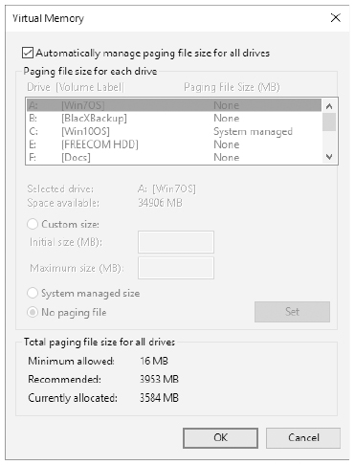
Tuning Virtual Memory
Figure 11-7 Configuring the paging file in Windows
Guide to Operating Systems, 5th Edition
Notes:
Tuning Virtual Memory

Slide 49
Tuning Virtual Memory
In UNIX/Linux – use the vmstat command-line utility to monitor paging
  If a swap file system is not already created, you can use the mkfs command in Linux to create it
In Mac OS X there is no option for turning on or configuring virtual memory because it is always enabled and monitored by the OS
Guide to Operating Systems, 5th Edition
Notes:
Tuning Virtual Memory
In UNIX/Linux – use the vmstat command-line utility to monitor paging
If a swap file system is not already created, you can use the mkfs command in Linux to create it
In Mac OS X there is no option for turning on or configuring virtual memory because it is always enabled and monitored by the OS

Slide 50
Installing Operating System Updates and Patches
Installing updates and patches is one of the most important ways to keep your OS tuned
You can obtain updates by using the Windows Update utility in all Windows OSs
  Windows 10 is configured to automatically download and install updates
Many Linux distributions with GNOME have a software update tool that allows you to automatically obtain updates
Mac OS X uses the App Store to deliver updates
Guide to Operating Systems, 5th Edition
Notes:
Installing Operating System Updates and Patches
Installing updates and patches is one of the most important ways to keep your OS tuned
You can obtain updates by using the Windows Update utility in all Windows OSs
Windows 10 is configured to automatically download and install updates
Many Linux distributions with GNOME have a software update tool that allows you to automatically obtain updates
Mac OS X uses the App Store to deliver updates

Slide 51
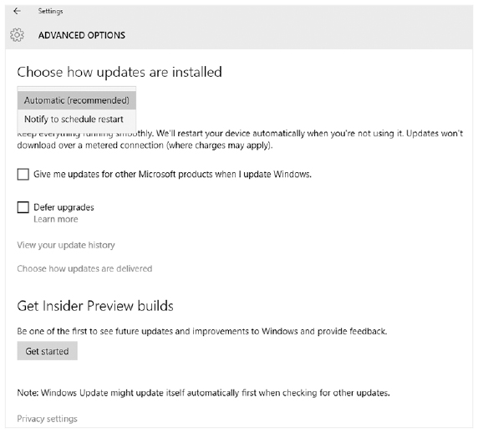
Installing Operating System Updates and Patches
Figure 11-8 Windows Update
Guide to Operating Systems, 5th Edition
Notes:
Installing Operating System Updates and Patches

Slide 52
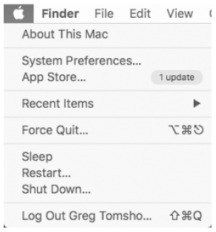
Installing Operating System Updates and Patches
Figure 11-9 Checking for updates on Mac OS X
Guide to Operating Systems, 5th Edition
Notes:
Installing Operating System Updates and Patches

Slide 53
Tuning for Network Communications
NIC cards used should be of high quality and designed for use in the computer’s fastest expansion slot
You should occasionally check for updated NIC drivers for your network interface card
NICs can sometimes saturate the network with repeated packet broadcasts – called a broadcast storm
Network traffic should be regularly monitored to make sure no node is creating excessive traffic
Guide to Operating Systems, 5th Edition
Notes:
Tuning for Network Communications
NIC cards used should be of high quality and designed for use in the computer’s fastest expansion slot
You should occasionally check for updated NIC drivers for your network interface card
NICs can sometimes saturate the network with repeated packet broadcasts – called a broadcast storm
Network traffic should be regularly monitored to make sure no node is creating excessive traffic

Slide 54
Testing Network Connectivity
ping utility – used to poll another network device
ping displays statistics that include the number of packets sent, received, and lost
  Also provides the round trip time in milliseconds
You can check the utilization of your network connection in Windows using the Performance tab in Task Manager
To check utilization of your interface in Linux, you may need to download and install a utility such as netdiag or netwatch
Guide to Operating Systems, 5th Edition
Notes:
Testing Network Connectivity
ping utility – used to poll another network device
ping displays statistics that include the number of packets sent, received, and lost
Also provides the round trip time in milliseconds
You can check the utilization of your network connection in Windows using the Performance tab in Task Manager
To check utilization of your interface in Linux, you may need to download and install a utility such as netdiag or netwatch

Slide 55
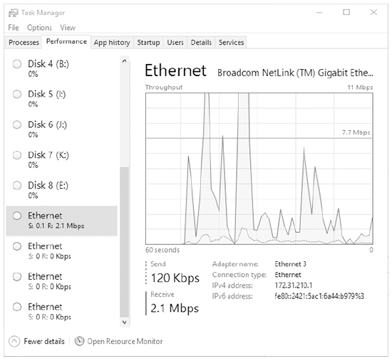
Testing Network Connectivity
Figure 11-11 Checking network interface utilization in Windows
Guide to Operating Systems, 5th Edition
Notes:
Testing Network Connectivity

Slide 56
Testing Network Connectivity
On Mac OS X, you can run Activity Monitor and check the Network tab to see what processes are using network bandwidth
  And to see basic statistics for the number of packets received and sent
Guide to Operating Systems, 5th Edition
Notes:
Testing Network Connectivity
On Mac OS X, you can run Activity Monitor and check the Network tab to see what processes are using network bandwidth
And to see basic statistics for the number of packets received and sent

Slide 57
Summary
Successful file system maintenance is closely linked to a computer’s folder structure
The file structure established on a computer is related to how easy it is to maintain that computer over the long term
One important practice for maintaining an OS is to regularly find and delete unused files
Use Disk Cleanup tool in Windows, the find, ls, and rm commands in Linux, and the Find utility in Mac OS X to find and delete unused files
Guide to Operating Systems, 5th Edition
Notes:
Summary
Successful file system maintenance is closely linked to a computer’s folder structure
The file structure established on a computer is related to how easy it is to maintain that computer over the long term
One important practice for maintaining an OS is to regularly find and delete unused files
Use Disk Cleanup tool in Windows, the find, ls, and rm commands in Linux, and the Find utility in Mac OS X to find and delete unused files

Slide 58
Summary
Other ways to maintain disks include defragmenting disks, moving files to relatively unused disks, finding and repairing disk problems, and setting up RAID
An important part of maintaining a system is to make regular backups
An important consideration for optimizing software installations is to make sure the software is compatible with computer hardware and OS
Guide to Operating Systems, 5th Edition
Notes:
Summary
Other ways to maintain disks include defragmenting disks, moving files to relatively unused disks, finding and repairing disk problems, and setting up RAID
An important part of maintaining a system is to make regular backups
An important consideration for optimizing software installations is to make sure the software is compatible with computer hardware and OS

